Slide 1

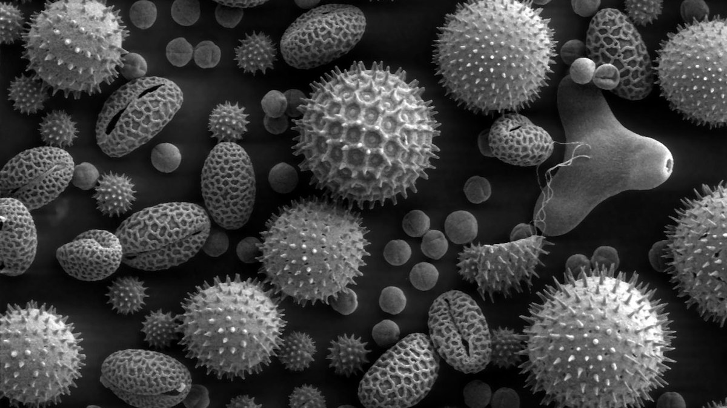

New analytical microscopy techniques: applications of a femtosecond laser
By: Ayush Fotedar
Supervisor: John C. Bridges (Prof.)
Collaboration with: Dr. Gareth Douglas

Slide 2
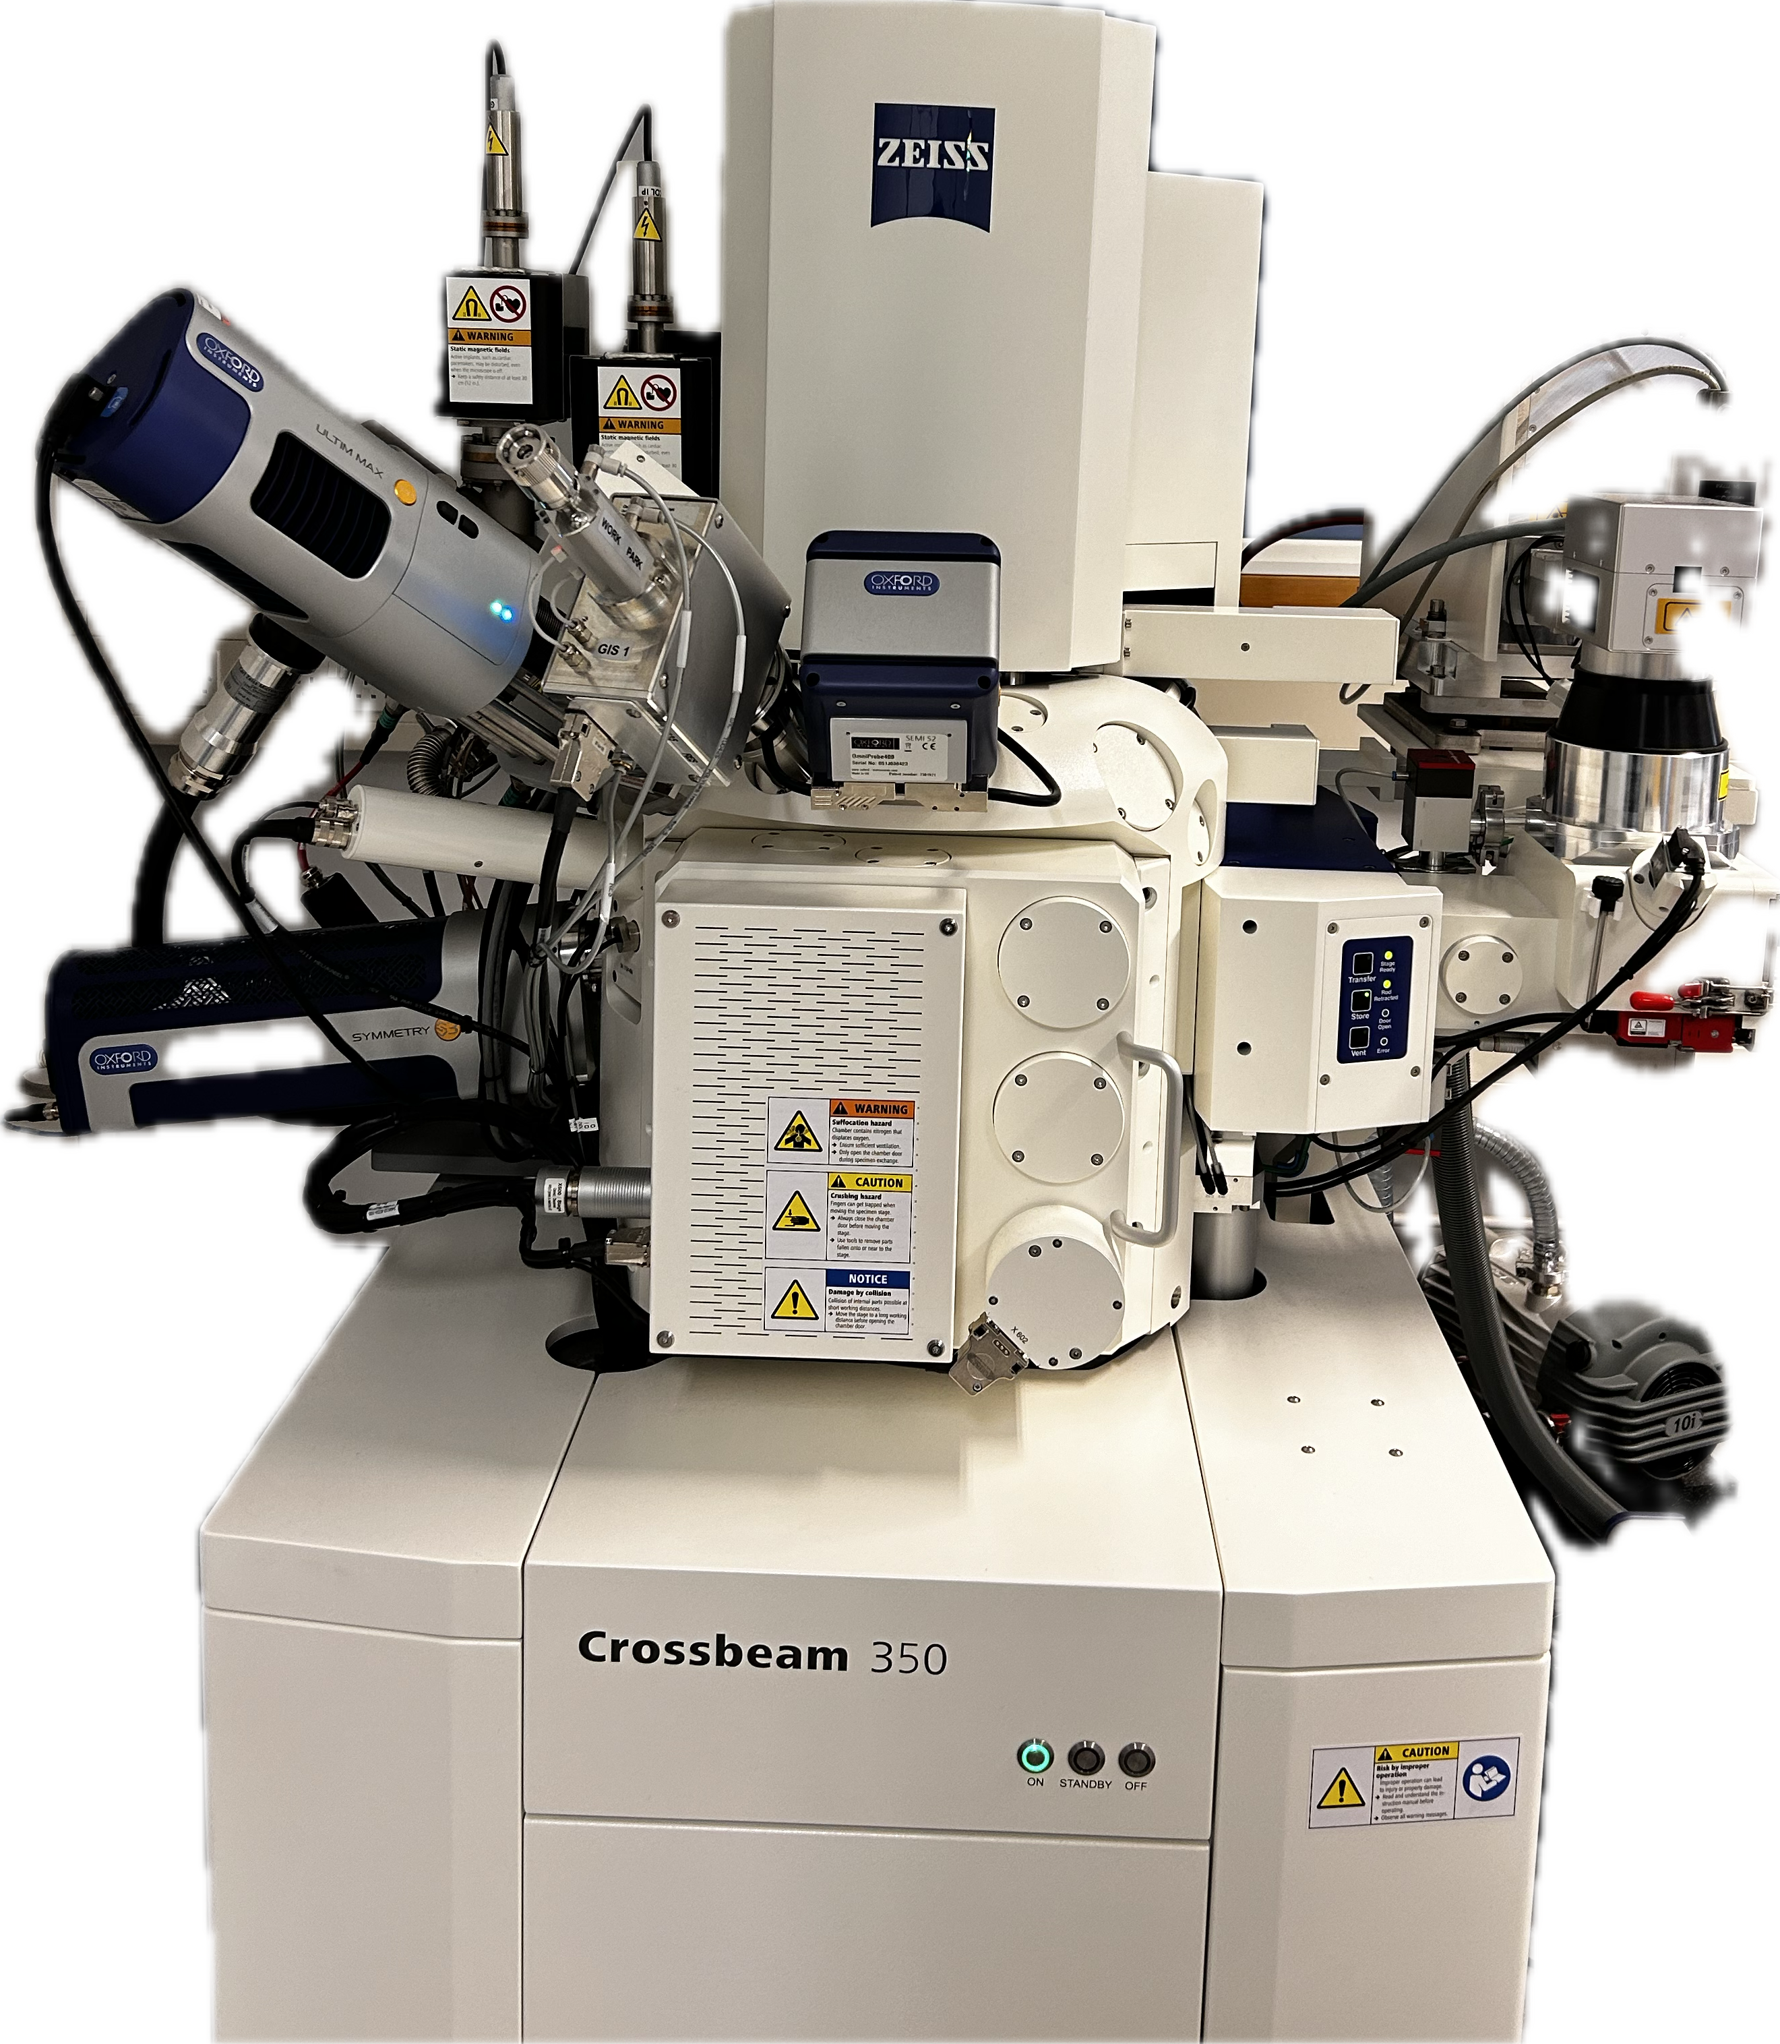
Introduction
What am I aiming to do?
What am I working with?
Why is it important?
Notes:
Build on the “laser effects”

Slide 3
What am I aiming to Do?
Using a femtosecond laser to study how different materials respond to laser ablation and how their properties change.
Running experiments on various materials to understand how femtosecond laser ablation affects material properties and performance.
Performing micromachining on various materials with the femtosecond laser and evaluating the precision and quality of the cuts.
Investigating the precision and control provided by femtosecond lasers to achieve high-quality material removal with minimal thermal impact.

Slide 4
Introduction
What am I aiming to do?
What am I working with?
Why is it important?
Notes:
Build on the “laser effects”

Slide 5
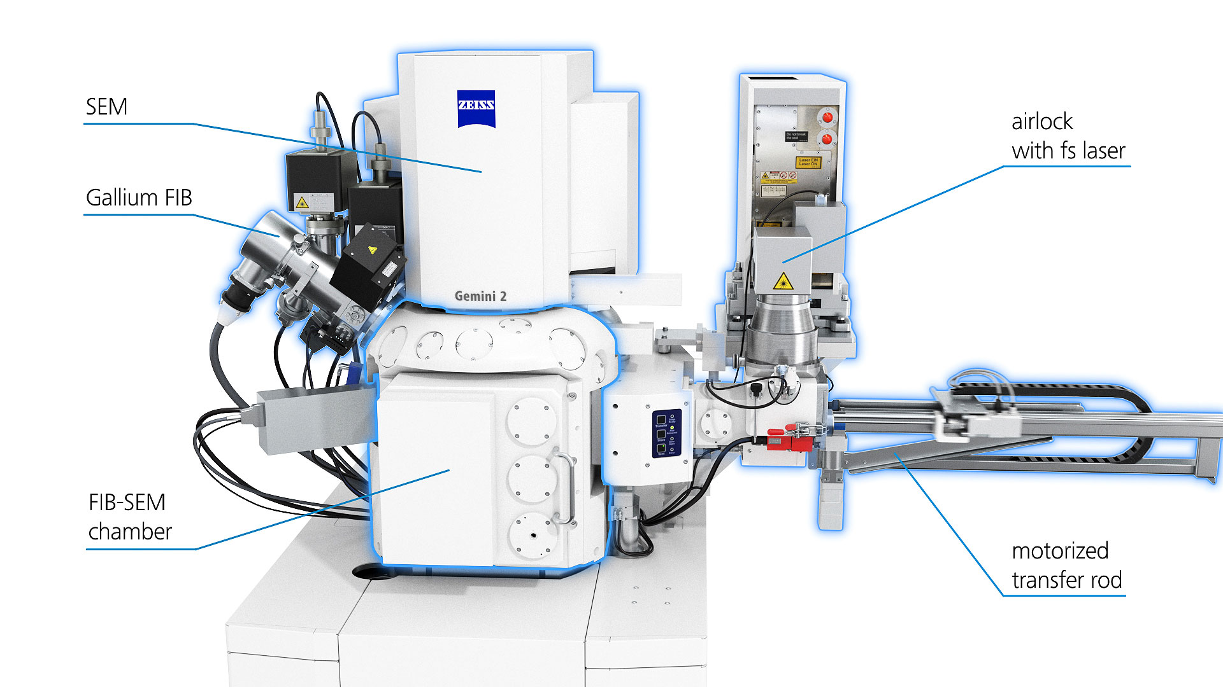
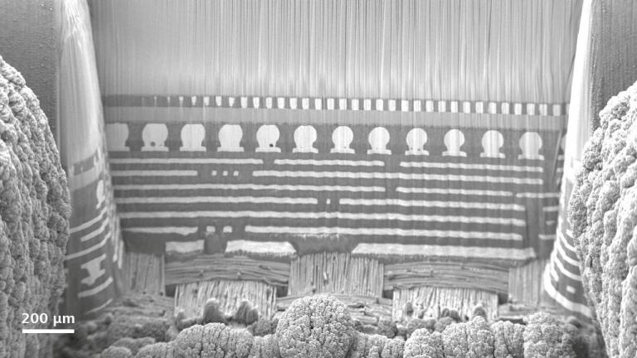
What am I working with?
Utilizing the Zeiss’ Crossbeam 350 FIB-SEM, equipped for low vacuum operations and in-situ experiments, ensuring high-quality imaging and high throughput thanks to the Gemini electron optics.
The femtosecond laser, integrated with the system’s airlock, enhances in-situ studies by preventing chamber contamination, enabling rapid access to deeply buried structures, and preparing large or high aspect-ratio structures with precision.
Zeiss: multi chip package with copper microbumps and flip chip interconnect, laser milled and FIB polished cross-section, trench depth 1.6mm [1]

Slide 6
Introduction
What am I aiming to do?
What am I working with?
Why is it important?
Notes:
Build on the “laser effects”

Slide 7
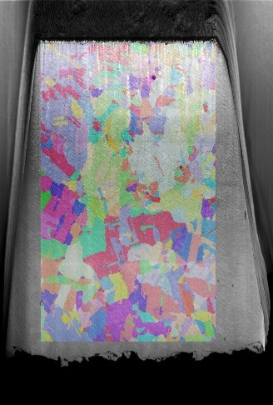
Why is it important?
Femtosecond lasers enable precise access to deeply buried regions of interest in 3D-scanned samples, such as those analysed by micro-CT, allowing for detailed topological analysis without damaging surrounding areas.
Exploring the potential of femtosecond lasers in machining instruments for space exploration offers a high-precision alternative to traditional methods,
This research evaluates whether femtosecond laser ablation can outperform traditional methods like nanosecond lasers and photo-chemical etching, particularly in terms of volume and size.
EBSD on laser prepared surfaces

Slide 8
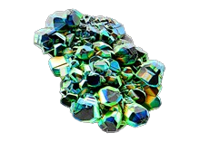
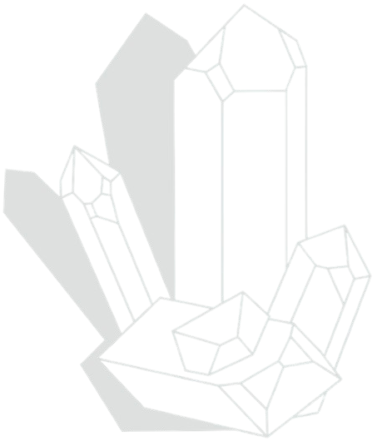
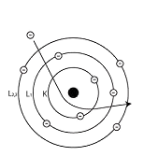

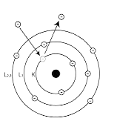

Scanning Electron Microscopy with Cathodoluminescence (SEM-CL) combines electron imaging with light emission analysis to study material properties and electronic structures through emitted light.
Electron Backscatter Diffraction (EBSD) is a technique that maps the crystallographic orientation and phase distribution of materials at high spatial resolution.
SEM-CL
EBSD
Backscattered Electrons (BSEs) are high-energy electrons reflected from a sample's surface, providing contrast based on atomic number and compositional differences in scanning electron microscopy.
Energy-Dispersive X-ray Spectroscopy (EDS) is a technique used to determine the elemental composition of a sample by analysing the X-ray spectra emitted from it.
SEM
BSE’s
EDS
WDS
SE’s
Wavelength-Dispersive X-ray Spectroscopy (WDS) is a technique for determining the elemental composition of a sample by analysing X-ray wavelengths with high precision.
Secondary Electrons (SEs) are low-energy electrons emitted from a sample’s surface, providing high-resolution imaging of surface topography in scanning electron microscopy.

Slide 9
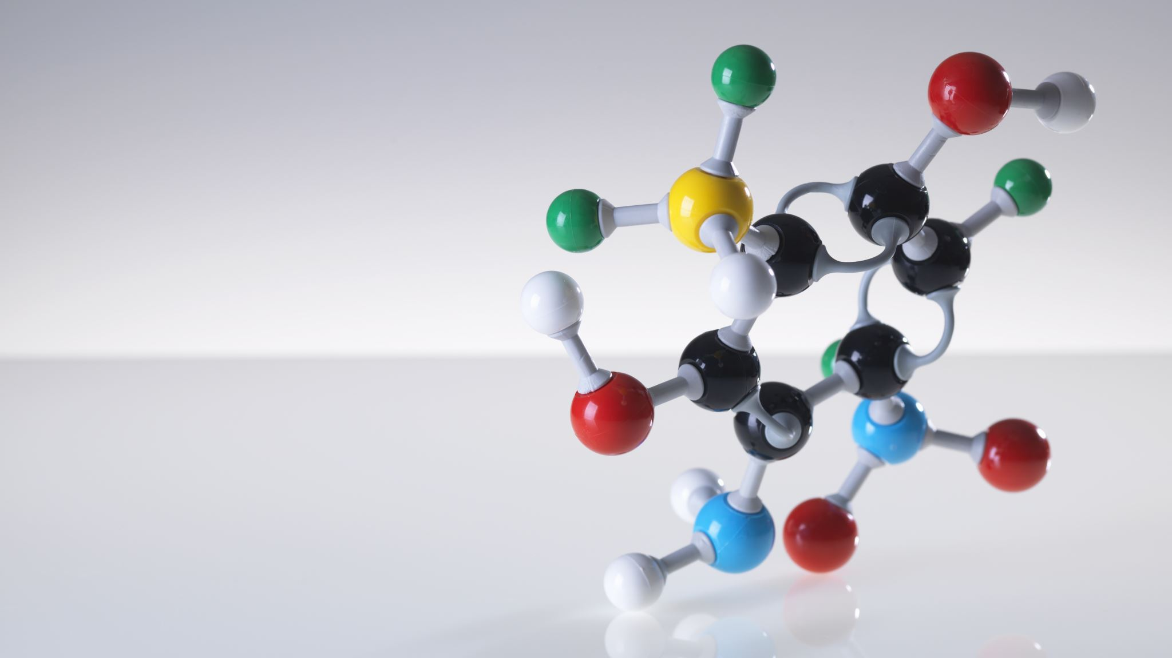
Secondary electrons imaging
Secondary electrons (SE) are generated when an incident electron passes close enough to an atom in the specimen to transfer some of its energy to a lower-energy electron. This energy transfer results in a slight energy loss and a change in the path of the incident electron, leading to the ionization of the electron within the specimen atom. The ionized electron, now with very low kinetic energy (around 5 eV), leaves the atom and is termed a "secondary electron." Each incident electron has the potential to produce several secondary electrons SEs originate from the surface or the near-surface regions of the sample.[2]
N
Inelastic Scattering

Slide 10
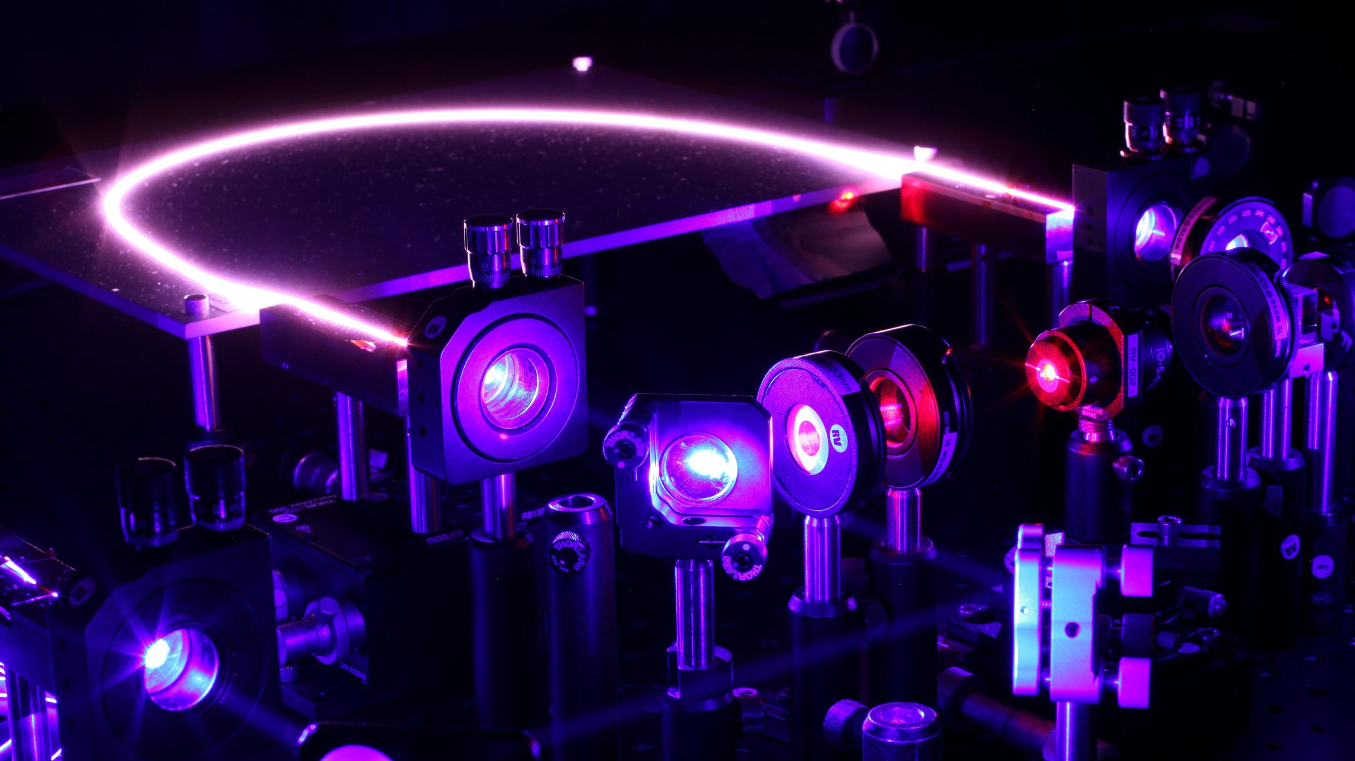
Femtosecond laser

Slide 11
Generation of a femtosecond laser pulse

Slide 12
What is mode locking?
Mode locking is a technique in optics where different frequency modes of a laser are synchronized (locked in phase) to produce a short pulse of light.
Before we explore mode locking, let's understand what happens when these modes are out of phase and in phase.
12

Slide 13
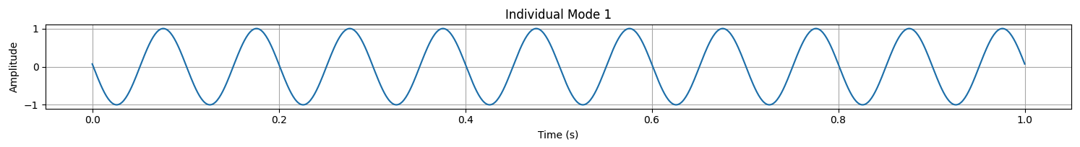
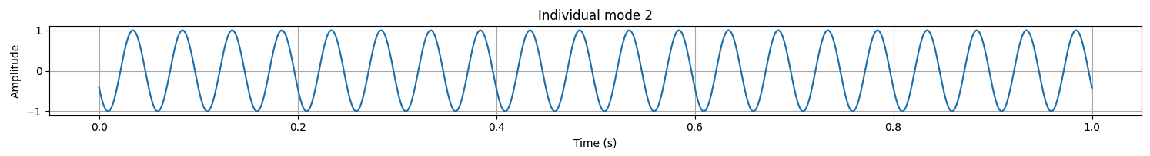
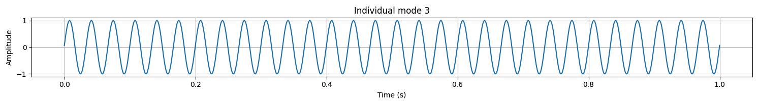
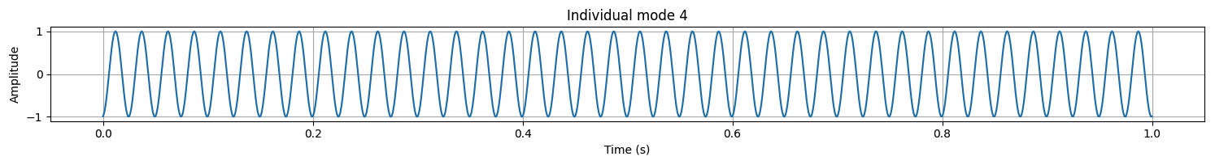




Mode 1: cos(20$πt+1.5$)
Mode 2: cos(40$πt+2.0$)
Mode 3: cos(60$πt−1.5$)
Mode 4: cos(80$πt −3.0$)
13

Slide 14
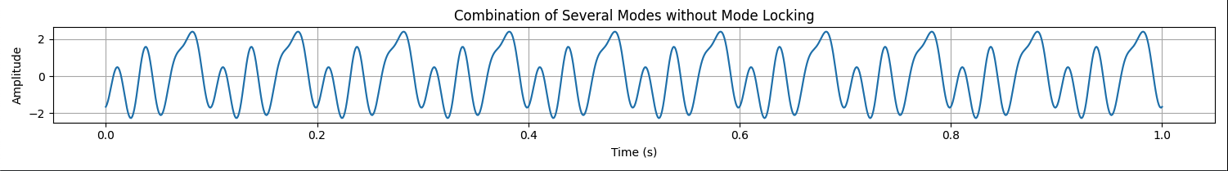
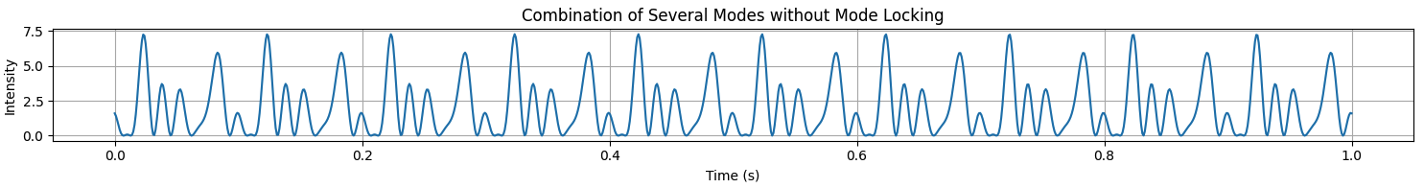
Superposition of these 4 modes

Slide 15
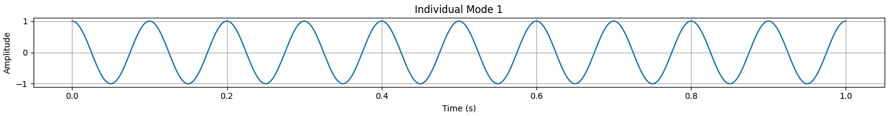
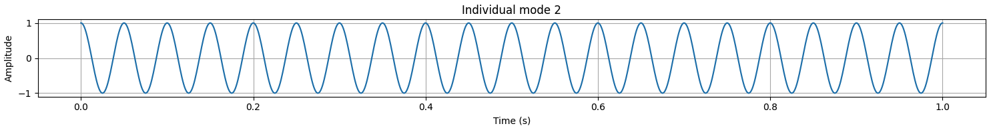
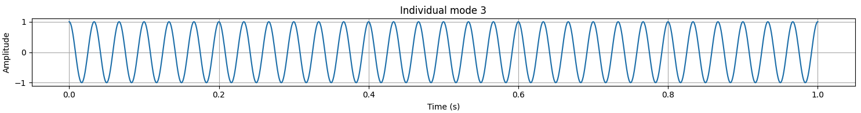
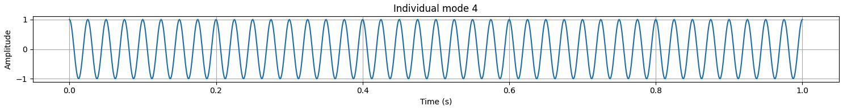
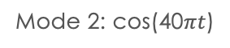
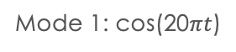
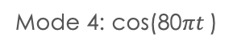
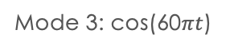
Mode 1: cos(20$πt$)
Mode 2: cos(40$πt$)
Mode 3: cos(60$πt$)
Mode 4: cos(80$πt$)
15

Slide 16
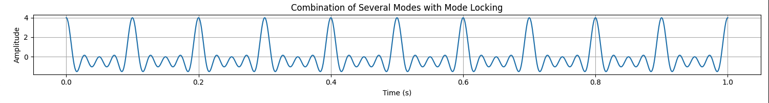
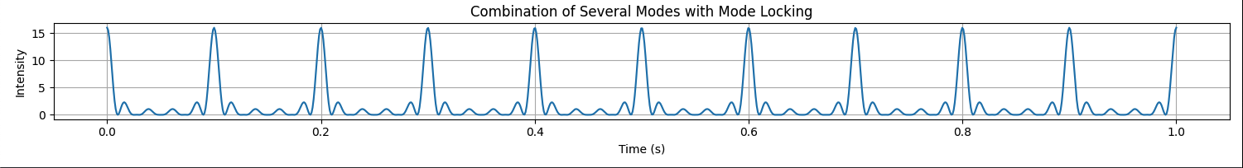
Superposition of these 4 modes

Slide 17
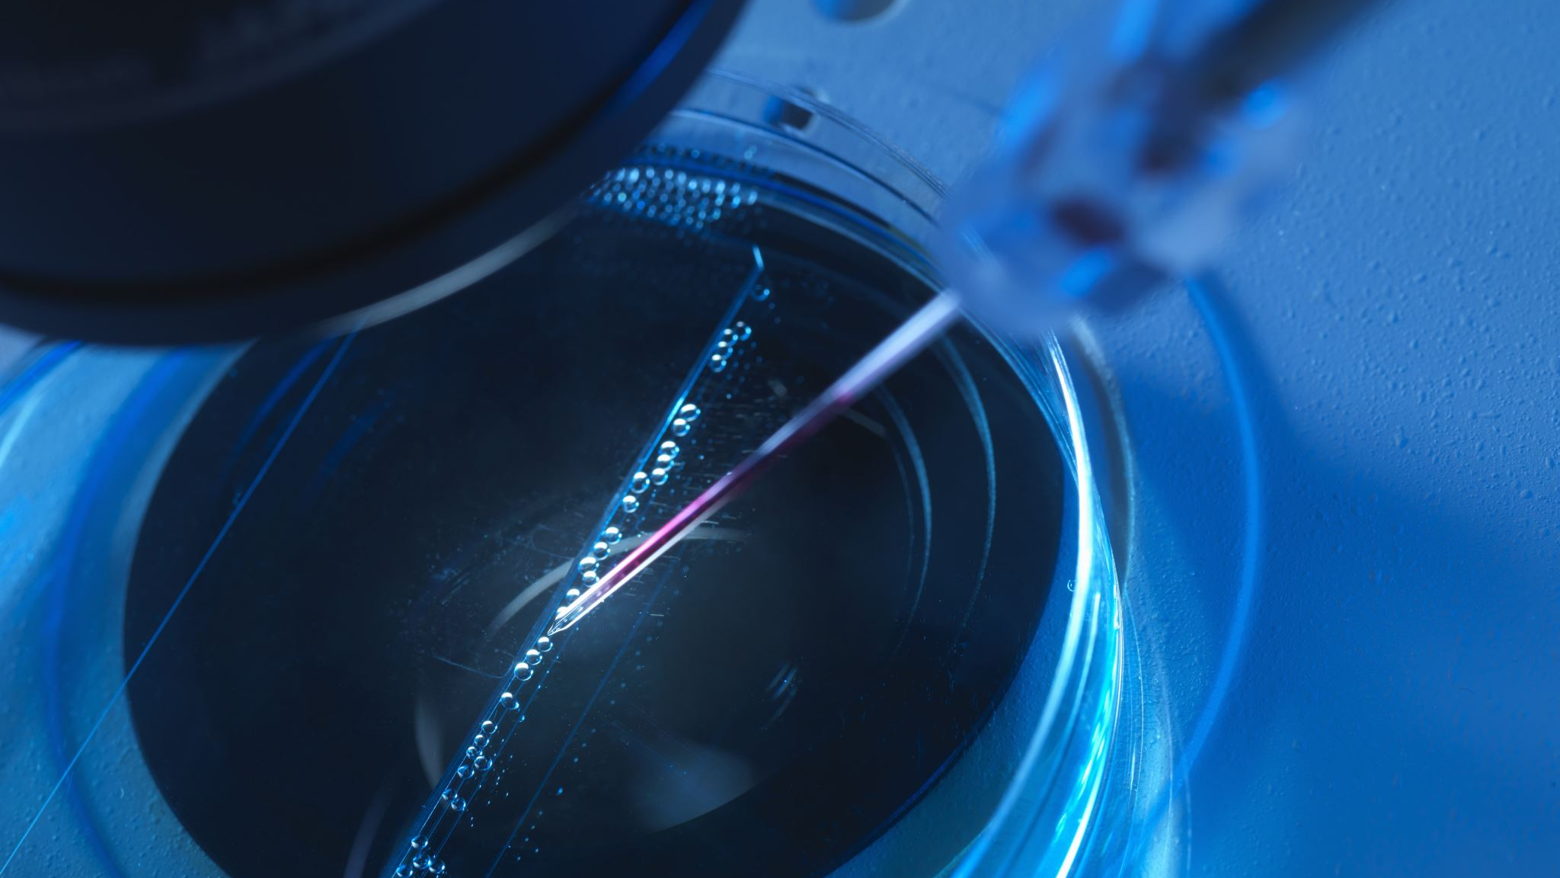
Sem based applications and testing of the femtosecond laser

Slide 18
Femtosecond micromachining
Femtosecond laser can be used for micromachining to expose the Region Of Interest (ROI) out in the open so that it can be analysed by the SEM (typically by Electron BackScattered Diffraction, EBSD).
In comparison to a continuous laser or a nanosecond pulsed laser, an ultra-short pulsed laser such as a femtosecond laser has minimal heat effects and instantly vaporises material.

Slide 19
Material 1: Aluminium
An aluminium stub was initially utilized to familiarize with the laser operation and to optimize the process parameters.
To assess the influence of laser parameters on material interaction—such as redeposition of ablated material, hatch spacing, and material removal rate—trenches were systematically created both at the center and edges of the sample.

Slide 20
Hatch Number Influence on Depth Consistency
Five trenches were created, each with a removal rate of 2 microns per layer. This means that with each hatching pass, 2 microns of material was removed by the laser.
The trenches were processed with varying numbers of hatches in increasing order to assess depth consistency.
The depth of each trench was calculated using the equation:
Depth = Removal Rate × Number of Hatches.

Slide 21

Laser recipes
A laser recipe is a predefined set of parameters and instructions used to control laser machining processes. It ensures consistent and repeatable outcomes in material processing.
Laser recipes are tailored to achieve desired material characteristics, such as precise cuts, smooth surfaces, or specific depths, by adjusting these parameters.

Slide 22

Recipe Used on aluminium
Laser Power (in %) | Scan Speed (in mm/s) | Frequency (in kHz) | Line Spacing (in $μm)$ | Number of hatches | Angle Increment | Removal rate per layer (in $μm$) | Hatching Strategy
100 | 900 | 300 | 4 | 50 | 19.00 | 2 | Rotating
100 | 900 | 300 | 4 | 100 | 19.00 | 2 | Rotating
100 | 900 | 300 | 4 | 150 | 19.00 | 2 | Rotating
100 | 900 | 300 | 4 | 200 | 19.00 | 2 | Rotating
100 | 900 | 300 | 4 | 250 | 19.00 | 2 | Rotating

Slide 23
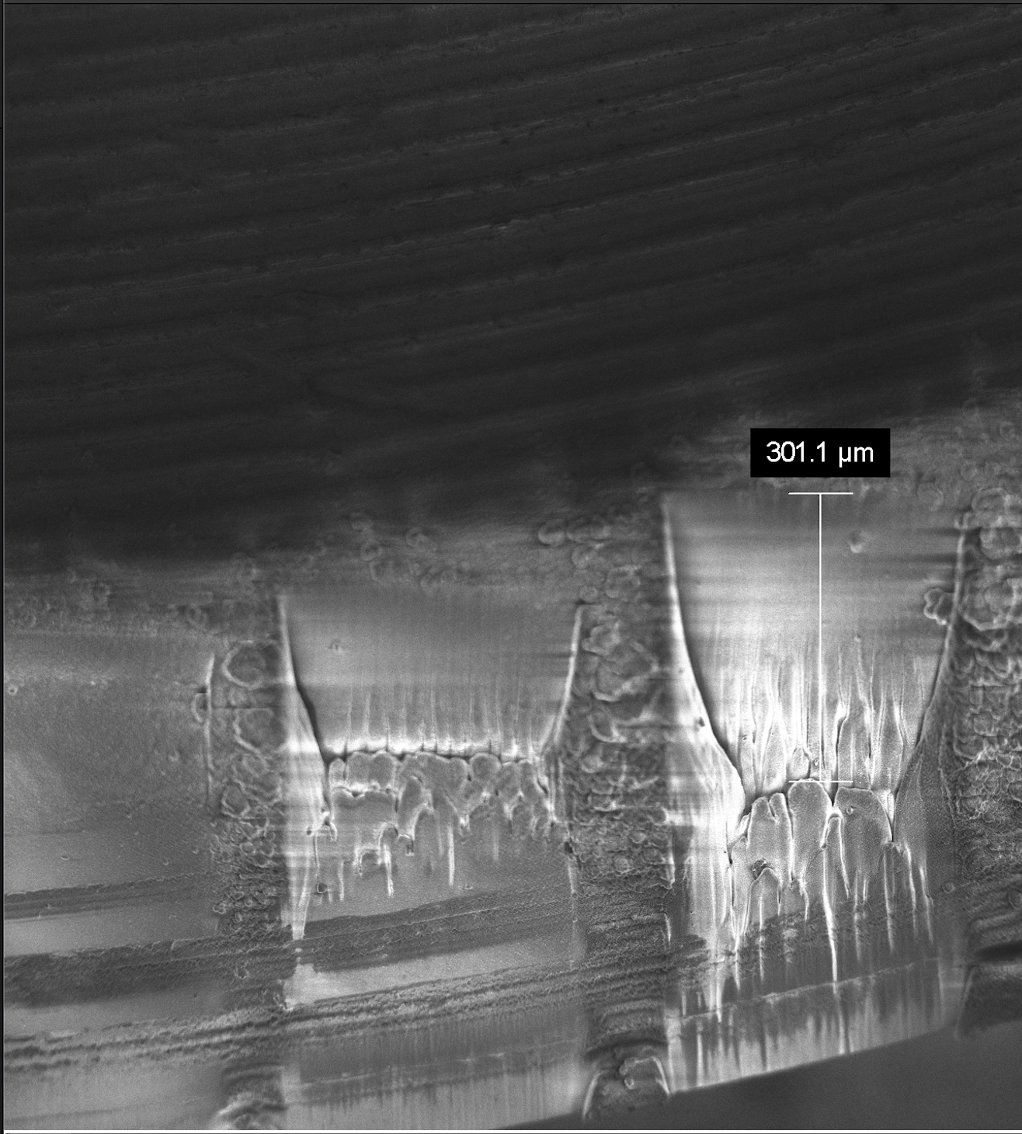
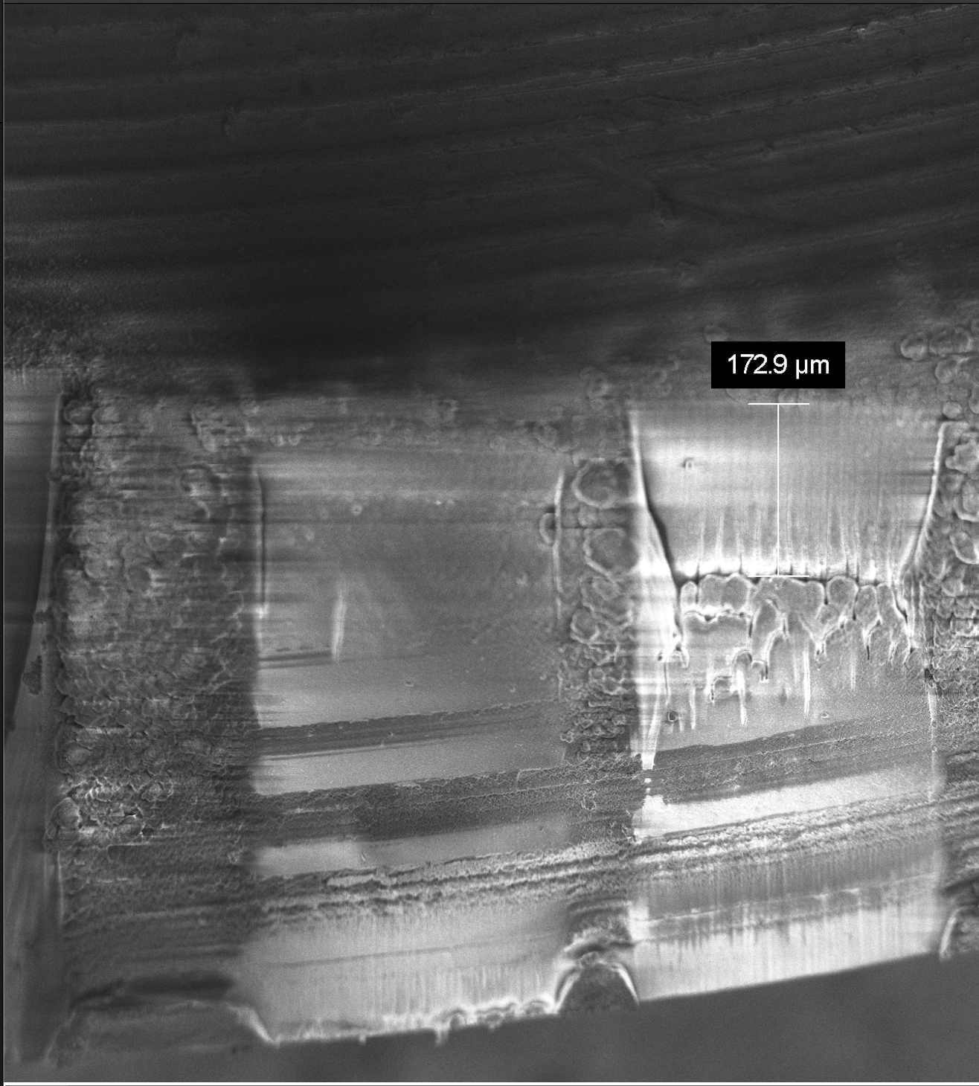
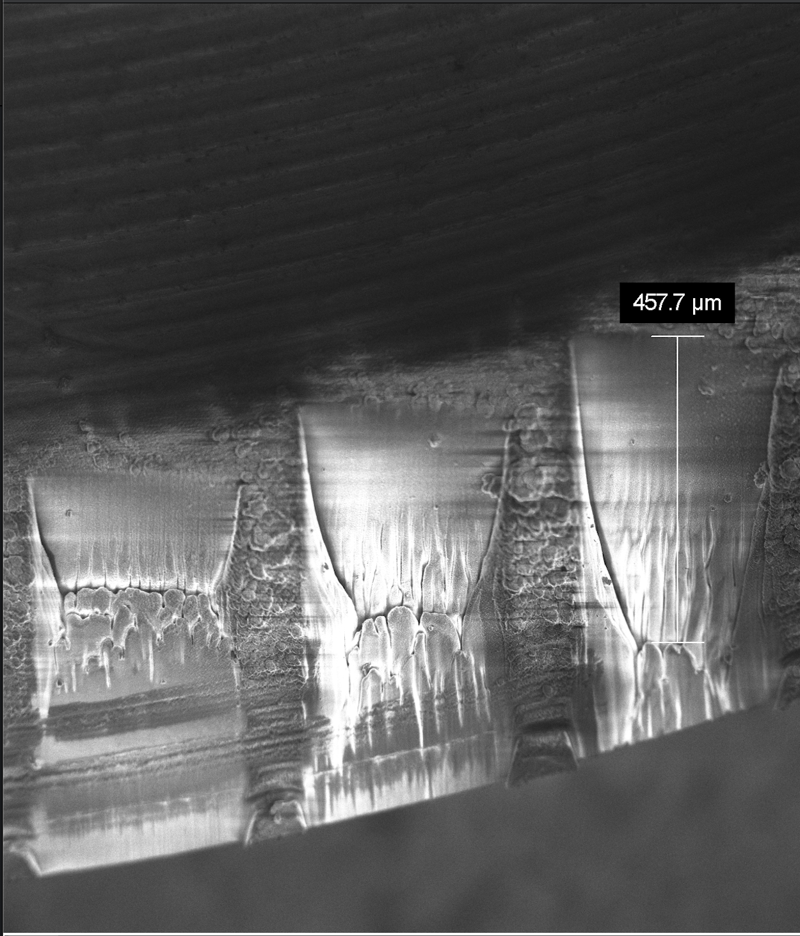
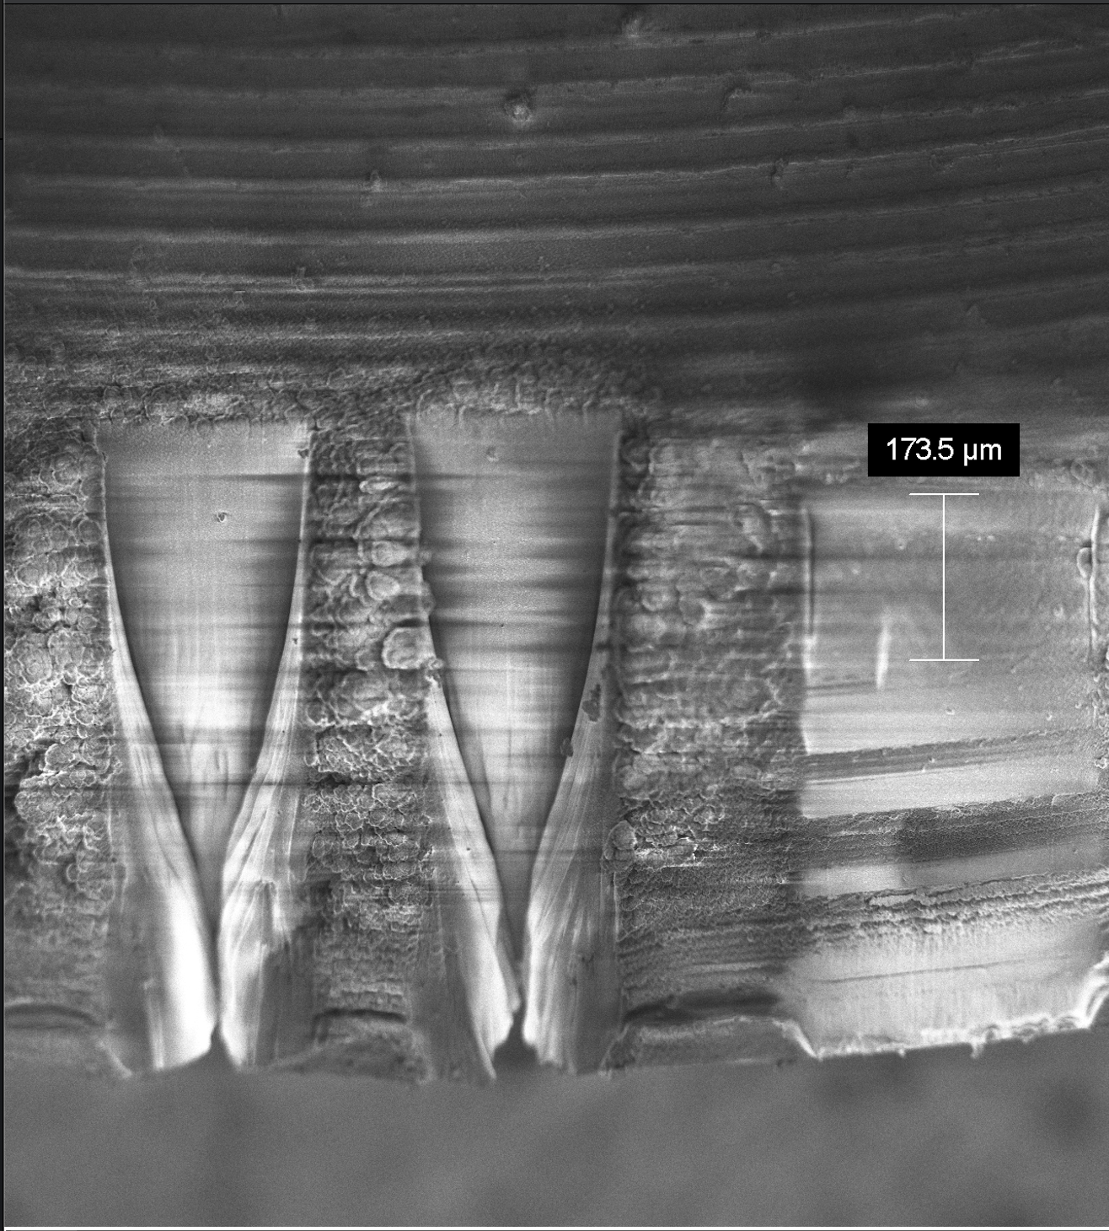
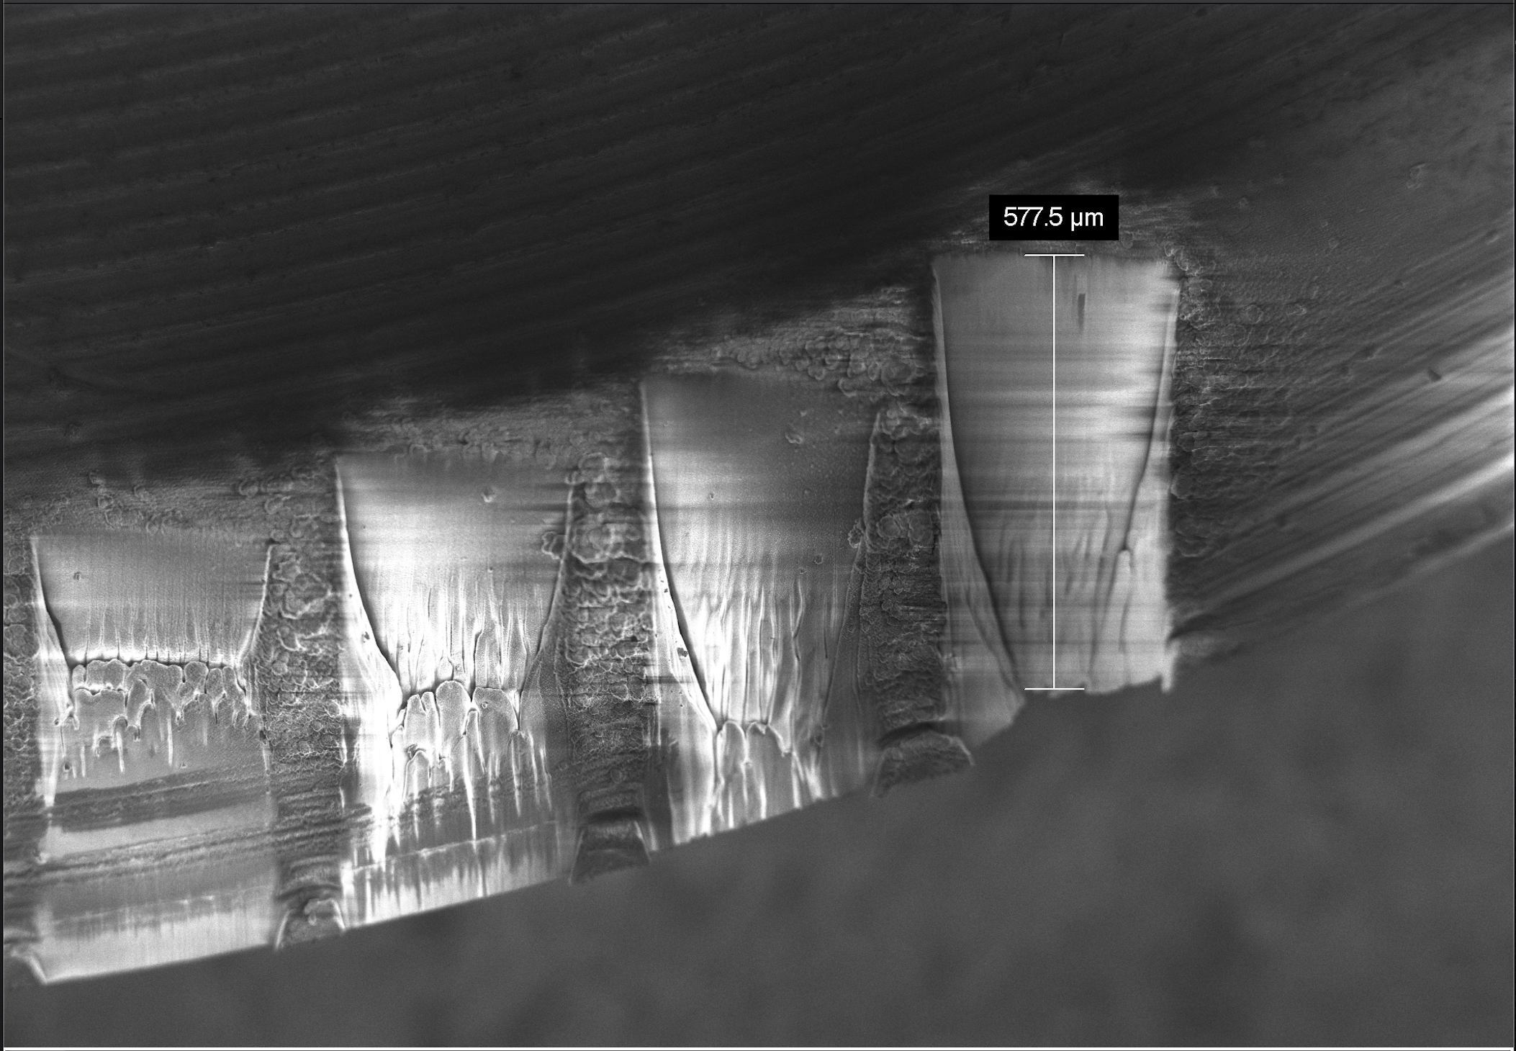
Trench 3
Trenches made at the edge of an aluminium stub
Trench 2
Trench 4
Trench 1
Trench 5

Slide 24
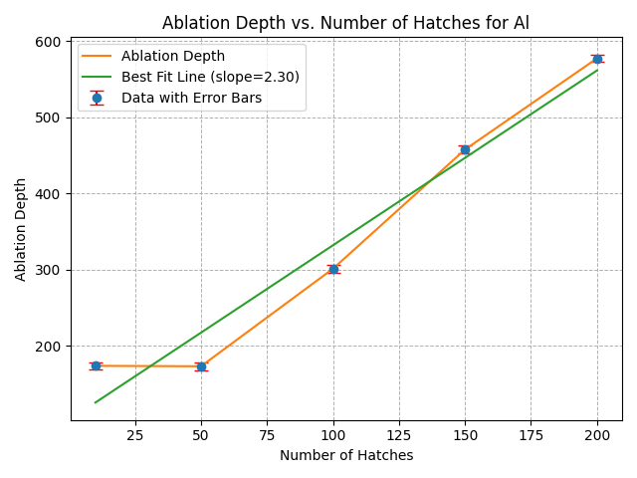
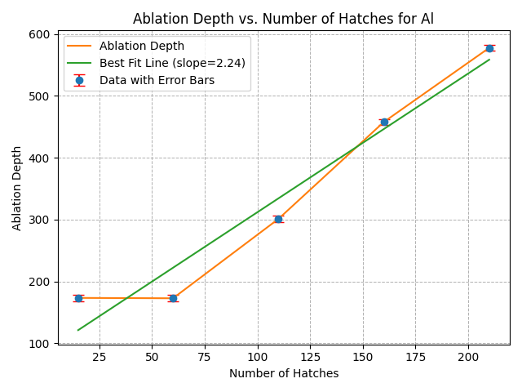
Ablation Depth vs. Number of Hatches for Aluminium
Hatches range : 10, 50, 100, 150, 200
Hatches range : 15, 60, 110, 160, 210
Experimental Value of Removal Rate Per Layer: 2.27$μm$
Analytical Value of Removal Rate Per Layer: 2 $μm$

Slide 25

Material 2: Stainless Steel
Objective:
Investigate the relationship between the trench depth and the power of a femtosecond laser when applied to steel.
Determine the ablation threshold, the minimum laser energy required to initiate material removal on the steel surface.
Expected Outcomes:
Trench Depth vs. Power Relationship: A detailed understanding of how trench depth scales with laser power at a fixed number of hatches.
Ablation Threshold: Accurate determination of the ablation threshold for steel, providing critical data for laser processing applications.

Slide 26

Recipe used to make the trenches
Pulse energy: 10 $μJ$
Base Frequency: 1000 kHz
Track Width: 0.012 mm
Power: Increasing from 40% to 100% for in steps of 20
Scan Velocity: 900 mm/s
Pulse Frequency: 300 kHz
Pulse Duration: 350 femtosecond
Number of hatches: 300 (1st dataset), 400 (2nd dataset)
Removal rate per layer: 2 $μm$

Slide 27
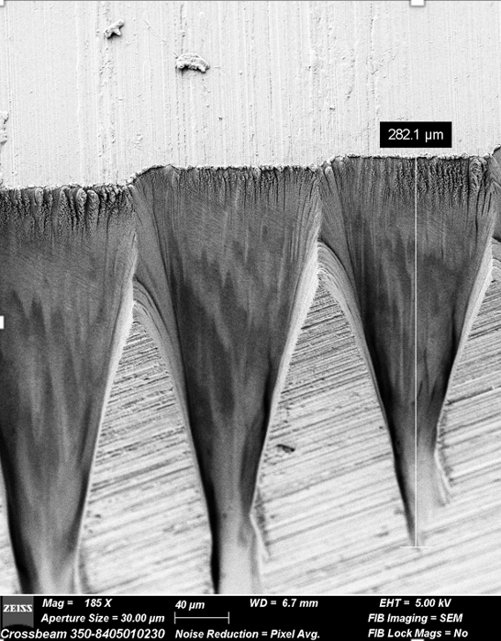
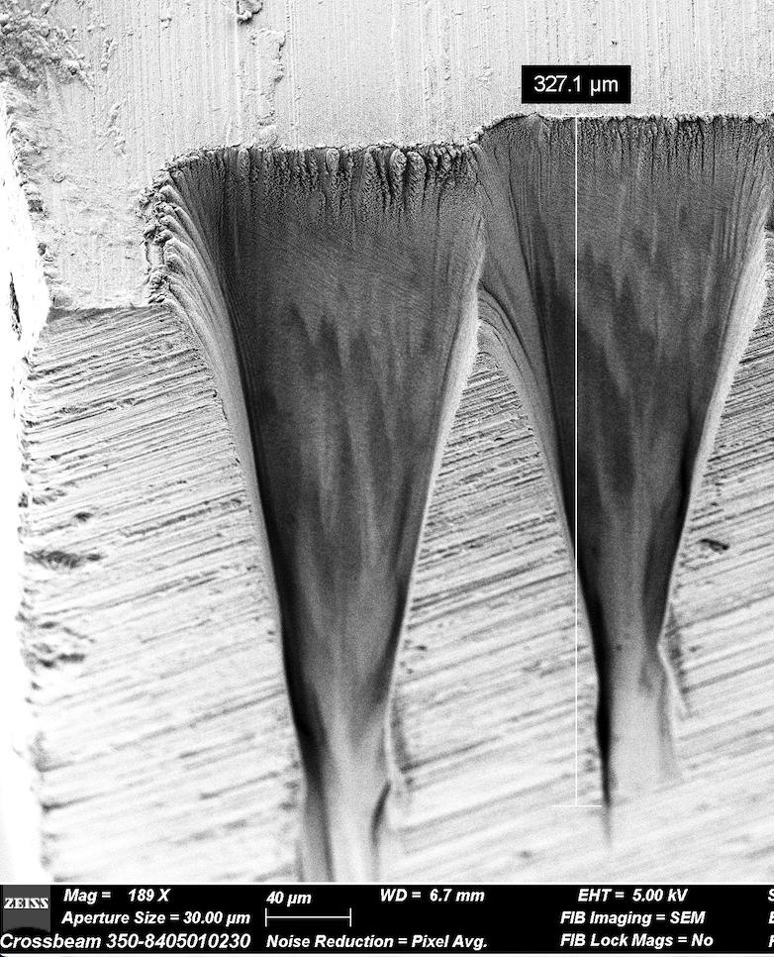
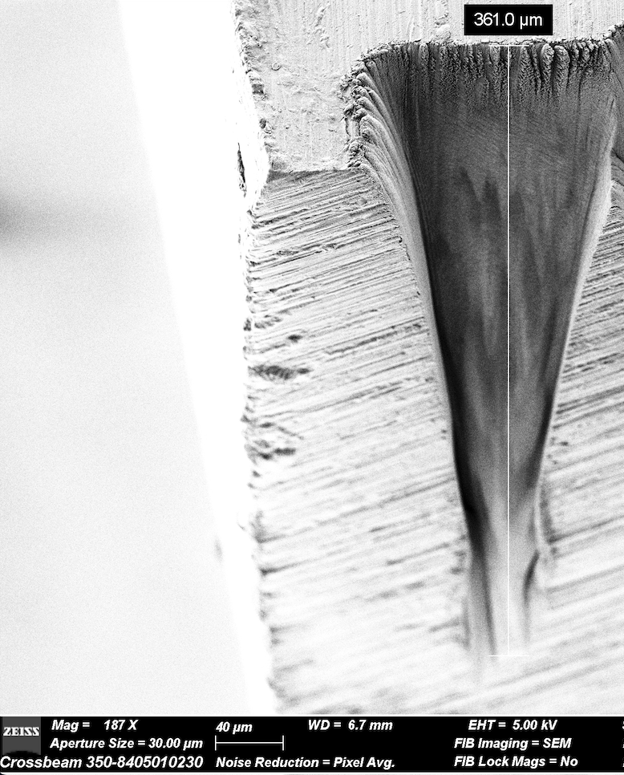
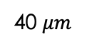
40 $μm$
Notes:
As you can see, the trenches are not quite parallel as they should be, and they seem to almost intersect and then separate. This is due to the non-linear effects of the laser

Slide 28
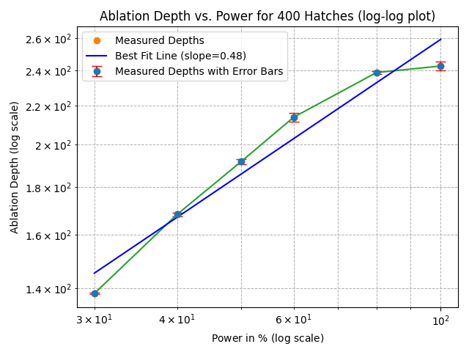
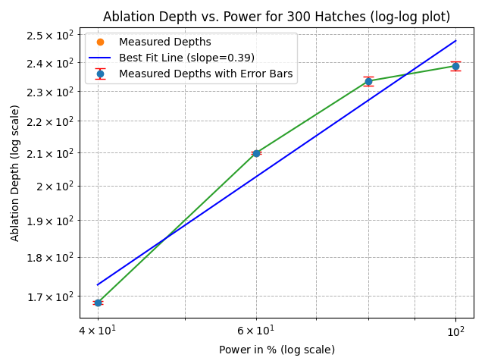
Analysis of Ablation Depth with Increase in Laser Power for Steel
Plateau suggests additional power no longer leads to significant material removal.

Slide 29

Self-Focusing in High-Intensity Femtosecond Laser Processing

Slide 30
Kerr Effect and Self-Focusing
Self-focusing is a nonlinear optical effect where the refractive index of a material becomes dependent on the intensity of the incoming laser beam. This leads to a concentration of the laser energy into a smaller cross-sectional area as the beam propagates through the material.
Kerr effect, which is the primary mechanism behind self-focusing, occurs when the refractive index of a material increases with the intensity of the electromagnetic field.

Slide 31
Self phase modulation
As the high-intensity femtosecond laser passes through a material, the laser's phase changes due to the intensity-dependent refractive index. This leads to a broadening of the pulse spectrum (i.e., spectral broadening), which can affect the energy distribution and ablation characteristics.

Slide 32
Ablation Threshold
The ablation threshold is a critical concept in laser-material interaction. It refers to the minimum amount of laser energy density (or fluence) required to remove material from the surface of a target.
Material Dependency: The ablation threshold varies significantly depending on the material's properties, such as its absorption coefficient, thermal conductivity, and specific heat capacity. Different materials require different energy densities to reach the ablation threshold.
Laser Parameters: The threshold is also influenced by the laser parameters, including pulse duration (e.g., femtosecond, picosecond, nanosecond), wavelength, and repetition rate. Femtosecond lasers often have lower ablation thresholds due to their ability to deliver energy extremely rapidly, minimizing heat diffusion and reducing thermal damage.

Slide 33

Recipe for experimental analysis of ablation threshold in steel
Pulse energy: 10 $μJ$
Base Frequency: 1000 kHz
Track Width: 0.01 mm
Power: Increasing from 10% to 100% for 10 craters
Scan Velocity: 100 mm/s
Pulse Frequency: 300 kHz
Pulse per dot: 200 (1st dataset), 1000 (2nd dataset), 5000 (3rd dataset)
Pulse Duration: 350 femtosecond
Number of hatches: 20
Removal rate per layer: 5 $μm$

Slide 34



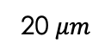
1000 pulse per dot crater at 20% power.
100 $μm$
20 $μm$
200 pulse per dot (top), 1000 pulse per dot (left) at 100% power.
10 $μm$
20 $μm$

Slide 35
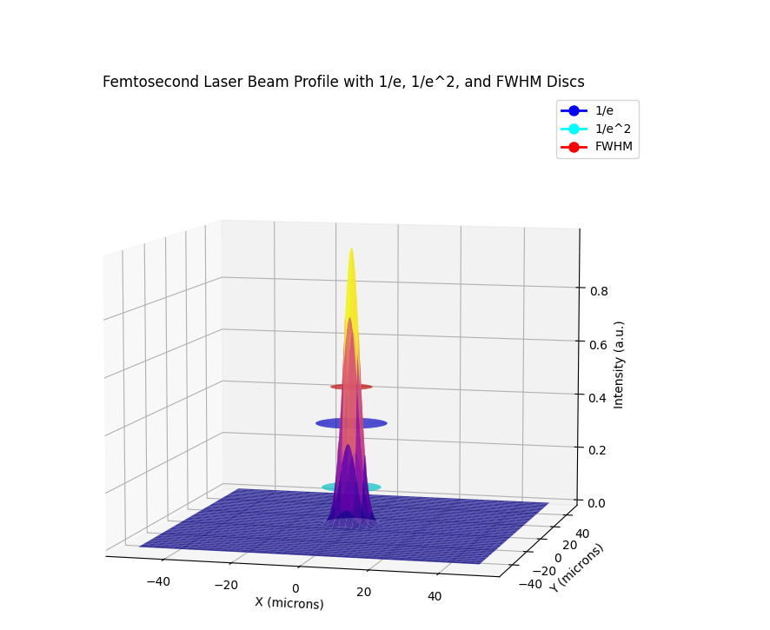
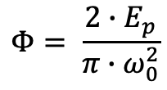
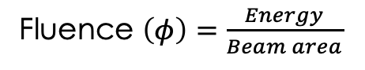
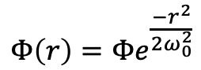
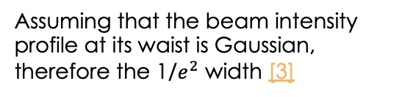
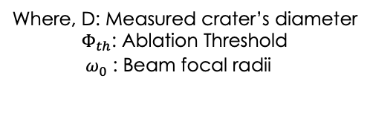
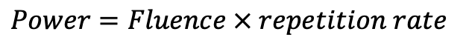
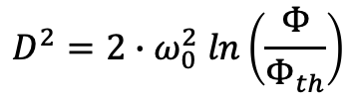
Theory Behind Ablation Threshold
Fluence $\left(φ\right)=\frac{Energy}{Beam area}$
$$Power=Fluence × repetition rate$$
Assuming that the beam intensity profile at its waist is Gaussian, therefore the 1/$e^{2}$ width [3]
$$Φ\left(r\right)=Φe^{\frac{{−r}^{2}}{2ω_{0}^{2}}}$$
$$Φ= \frac{2∙E_{p}}{π∙ω_{0}^{2}}$$
1
2
3
$$D^{2}=2∙ω_{0}^{2} ln\left(\frac{Φ}{Φ_{th}}\right)$$
Where, D: Measured crater’s diameter
${ Φ}_{th}$: Ablation Threshold
${ ω}_{0}^{}$: Beam focal radii
spatial distribution of fluence (Φ) as a function of distance r from the center of a Gaussian laser beam.
fluence (Φ) of a laser beam.
relationship between the ablation crater diameter (D) and the fluence (Φ) of the laser beam.

Slide 36


Literature value: 0.15$±$ 0.03 J/${cm}^{2}$[4]
Experimental Value: 0.157 $±$ 0.027 J/${cm}^{2}$

Slide 37
Material 3. Monocrystalline Silicon {100}
Polishing the Noses of Trenches:
Applied polishing techniques using the femtosecond laser to smoothen the edges and noses of the trenches.
Objective: Achieved a higher surface finish quality by reducing roughness and imperfections caused during the ablation process.

Slide 38



Generalised plan for polishing

Slide 39


Silicon nose polishing

Slide 40

Limitations of fs-laser

Slide 41


1. Redeposition
50 $μm$
Redeposition Issues: Vaporized material from ablation can redeposit on surrounding surfaces, leading to contamination or altered surface properties.
A cross jet (gas flow of nitrogen or argon gas) is used to protect the laser optics by preventing ablated material from depositing on the protective glass. [5]
However, the cross jet often redirects ablated material back onto the sample surface, causing redeposition.
This redeposition reduces the precision of the micromachining process.
30 $μm$
Image 1: Trench dug out in aluminium with cross jet off
Image 2: Trench dug out in aluminium with cross jet on

Slide 42

Laser induced Periodic surface structures (LIPSS)
Surface Functionalization: LIPSS can be used to modify surface properties such as hydrophobicity or hydrophilicity. For example, it can create water-repellent or water-attracting surfaces, useful in self-cleaning materials or anti-fogging coatings.
Optical Interference: In optical applications, LIPSS can scatter light and cause diffraction, which may degrade the performance of components such as lenses, mirrors, or sensors. This effect is particularly problematic in systems requiring precise control of light propagation.
1 $μm$
1000 nm

Slide 43

Curtaining
formation of wave-like or striated patterns on the surface of a material during femtosecond laser ablation. This occurs due to the uneven removal of material layers, often exacerbated by the presence of different densities or material interfaces.
Curtaining can degrade the surface quality of the material being processed. This is especially problematic in precision applications where smooth and uniform surfaces are critical, such as in semiconductor fabrication or microelectromechanical systems (MEMS).

Slide 44
Femtosecond Laser vs Alternative Fabrication Processes

Slide 45



Nanoscale precision
High-resolution milling
Slower, gallium contamination
Gallium Focused Ion Beam (Ga-FIB)
Femtosecond Laser
Working scale: $nm −μm$
High precision at micro/nano scales
Complex
geometries
Micromachining applications,
intricate
patterns &
structures
Advanced fabrication
Specialised application
Ultra-short pulse duration
Minimal heat-affected zones
Challenges: Redeposition, LIPSS
Cost-effective for large scale Batch processing
Chemical compatibility limits
Effective for various materials
Non-contact processing
Working scale: $μm −mm$
Photo-Chemical Etching (PCE)
Working scale: $mm −cm$

Slide 46
Next Steps:
Work more on polishing surfaces by trying different recipes
Work on different and new materials to understand their property
Fabricate diffraction gratings on silicon crystal despite LIPSS to investigate the optical effects of it

Slide 47
references
ZEISS Crossbeam Family. (n.d.). Www.zeiss.com. https://www.zeiss.com/microscopy/en/products/sem-fib-sem/fib-sem/crossbeam.html [1], [5]
Nanakoudis, A. (2019, November 21). SEM: Types of Electrons and the Information They Provide. Advancing Materials. https://www.thermofisher.com/blog/materials/sem-signal-types-electrons-and-the-information-they-provide/ [2]
Orlandini, A., Baraldo, S., Porta, M., & Valente, A. (2022). Ablation threshold estimation for femtosecond pulsed laser machining of AISI 316L. Procedia CIRP, 107, 617–622. doi:10.1016/j.procir.2022.05.035 . [3]
Orzi, Daniel & Alvira, Fernando & Bilmes, G.. (2012). Determination of femtosecond ablation thresholds by using laser ablation induced photoacoustics (LAIP). Applied Physics A. 110. 10.1007/s00339-012-7230-x. [4]
‌

Slide 48
Thanks for listening
Questions?

